Slide 1
Plant Map for Rectangular Pollinator Garden
Rear
7
8
2
11
8
6
6
10
7
19
20
20
13
6
19
1
2
2
13
20
21
10
1
20
6
3
3
17
16
4
19
2
19
21
1
19
4
22
22
4
5
11
19
11
5
11
3
21
12
6
1
15
19
4
12
5
22
19
2
4
4
12
11
12
1
5
5
9
22
18
21
?
16
1
5
12
18
17
16
16
14
14
14
9
15
Front
0
5
See Map Key
Scale:
10-10-2019
feet

Slide 2
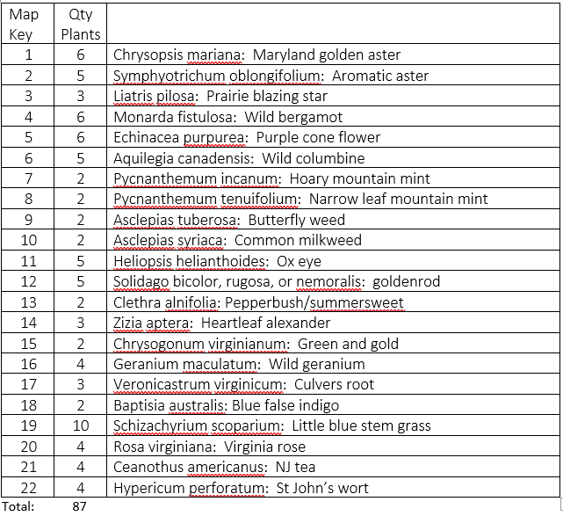
Map Key for Pollinator Garden: Plot E

